Slide 1
Group Project Level 4/5 Group 1
Aaron K Benjamin A,
George F Joe W

Slide 2
Logline
2D puzzle platformer where the player must follow another survivor while avoiding the perils of a hostile environment by solving puzzles.

Slide 3
Target Audience
Male and female (Mostly males)
Aged between 16-28
Have an interest in puzzles, old school games and narrative

Slide 4
Emotions
Chrysalism: The amniotic tranquility of being indoors during a thunderstorm.
Adronitis: Frustration with how long it takes to get to know someone.

Slide 5
Mechanics
Platformer
Enemy Avoidance
Strategy
Non violent approach to dealing with levels
No weapons
Using puzzles to dispatch enemies

Slide 6
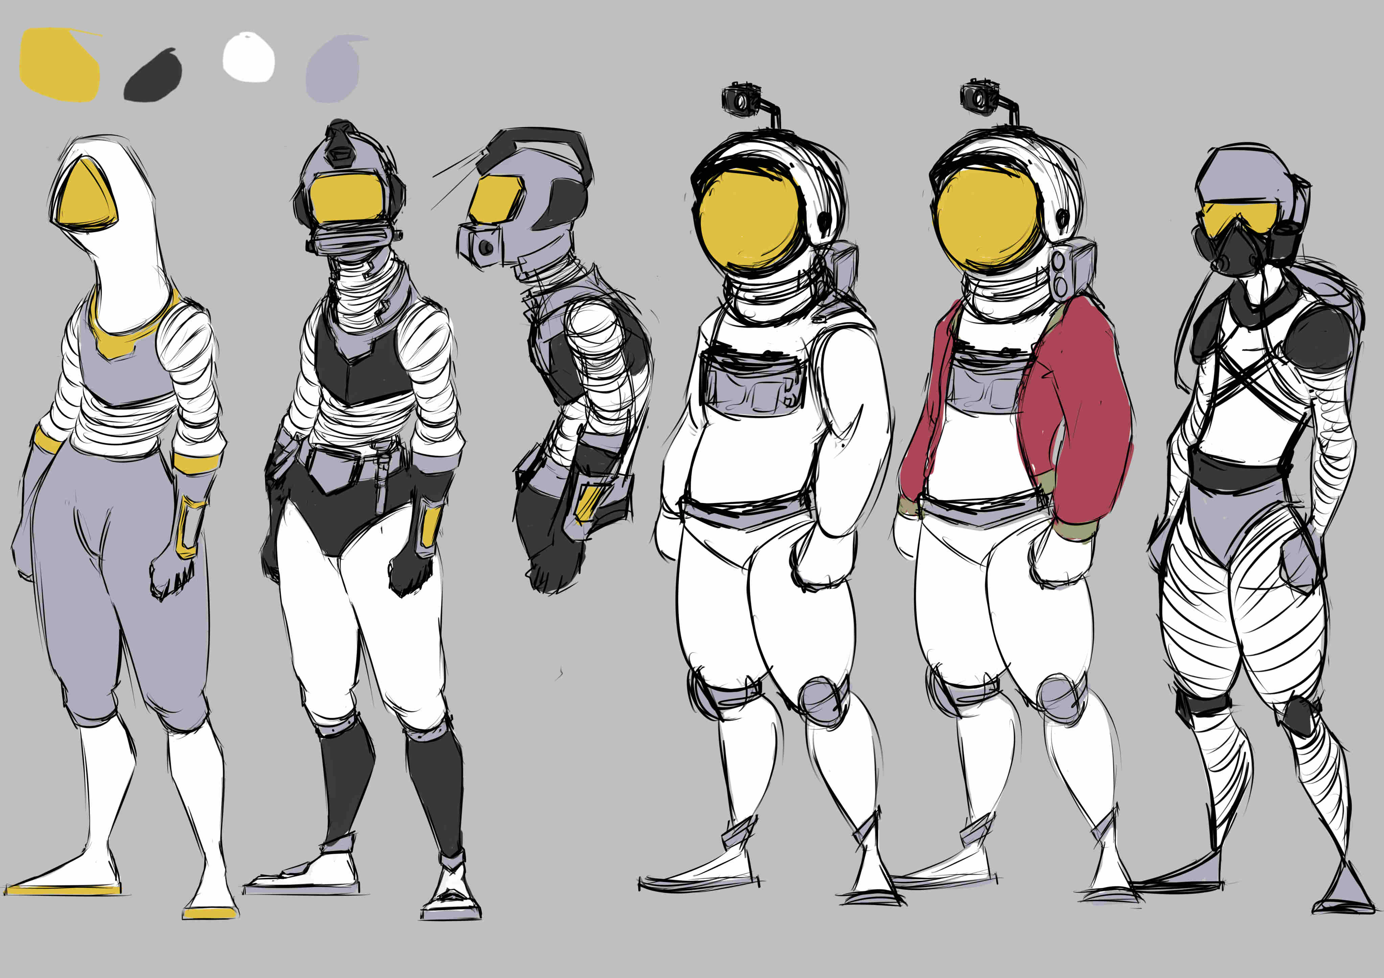
Character Design
Astronaut / Diver

Slide 7
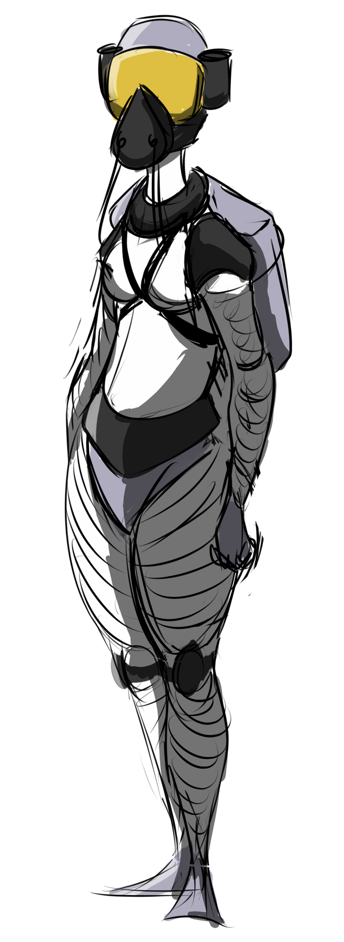
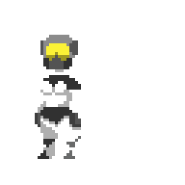
Character Design
Survivor
Female
Maternal
Sex

Slide 8
Character Design
Enemies

Slide 9
How Mechanics reinforce the emotions
Outside world is hostile
Obstacles in the form of avoiding the enemies
Stops player from getting to survivor they’re chasing
Builds frustration
Indoors is calm
Conflict with the enemies outside builds tension
Tension is released Indoors reinforcing the calm
Contrasts the hostile outside

Slide 10
Interior
Calm
Place to pause after frustration of outside
Reinforces harshness of the outside
Tells a story of past survivor

Slide 11
Outside

Slide 12
The Game

Slide 13
Group Management
Hours logged so far
Aaron
36h
Ben
40h
George
32h
Joe
30h

Slide 14
What we have learnt
How the mechanics can drive the rest of the game
Focusing on how fewer mechanics can provide elegant solutions to problems in designing and making the game

Slide 15
Questions?

